Slide 1
Distributed Training
Presented by Aditya Roy and Alex Behr

Slide 2
The Problem
Training takes too long.
Training sometimes also takes more GPU memory than is typically (or ever) available.
State of the art models are only getting larger and larger.
We want to find ways to train models in less time and using smaller GPU footprints.

Slide 3
Current Distributed Solutions
Data parallelism
Workers perform the full training process on a subset of the data and synchronize learned results.
Reduces total training time.
Model parallelism
Workers split the model into parts and perform only a subset of the computation. It requires communication between multiple workers to complete one forward-backward pass.

Slide 4
The Papers
Tofu - reducing the GPU footprint for very large DNNs
Prague - faster and more robust data parallel training
ByteScheduler - a generic communication scheduler leveraging data parallelism for accelerating distributed DNN training

Slide 5
Supporting Very Large Models using Automatic Dataflow Graph Partitioning
Minjie Wang, Chien-chin Huang, Jinyang Li
New York University

Slide 6
The Problem
Very large DNN models are at the forefront of cutting edge ML research.
The trend is that state of the art models are only going to get larger (doubling every 2.4 years).
Yet their size is constrained by GPU device memory.

Slide 7
Previous Solutions
Various techniques have been found to run models on GPUs which have smaller memory than the batch size of the model.
Capuchin and algorithms like it allow for data to be swapped to other memory or recomputed and reduce required footprint at the cost of throughput.
Model parallelism allows model data to be split across multiple devices for either an increase in throughput or to reduce GPU footprint.
Splitting the model by layers is also currently done, but this can prove to be too coarse as the tensors required to compute some layers (such as very large CNNs) can still be too large to compute on a single GPU.
Partitioning at the tensor level can provide finer partition granularity. This has been tested with some success but with manual configuration at the layer level.

Slide 8
The Tofu Solution
Tofu is a system for implementing tensor partitioning automatically without manual configuration. The steps are:
Describe the model operations in TDL (Tensor Description Language).
Generate a dataflow graph.
Apply graph coarsening to simplify the graph.
Generate partition strategies with recursive application of a Dynamic Programming (DP) algorithm.
Optimize the model to assure proper memory management by ML framework.

Slide 9
Context / Limitations / Caveats
Only uses Partition-n-Reduce partition strategy.
TDL cannot describe certain operations (i.e. Cholesky decomposition).
Does not leverage communication topology among workers.
Can leave some GPUs unsaturated at some steps.
Targeted only at DNNs whose batches are too large to fit in a single GPU.
Only tested on single machine architecture.

Slide 10
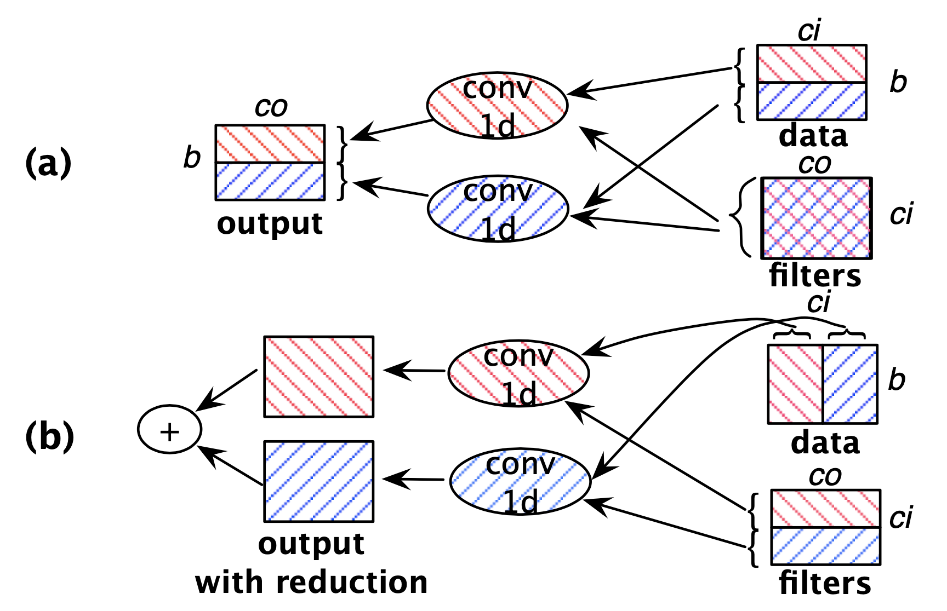
Operator Partitioning
The basic idea is that the input and output tensors of an operator can be partitioned based on the the dataflow through that operator.
The figure on the right shows the two categories of partition-n-reduce.
Figure 2.

Slide 11
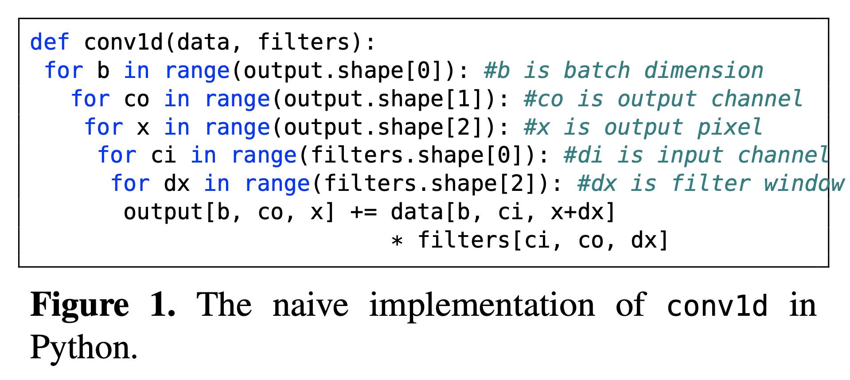
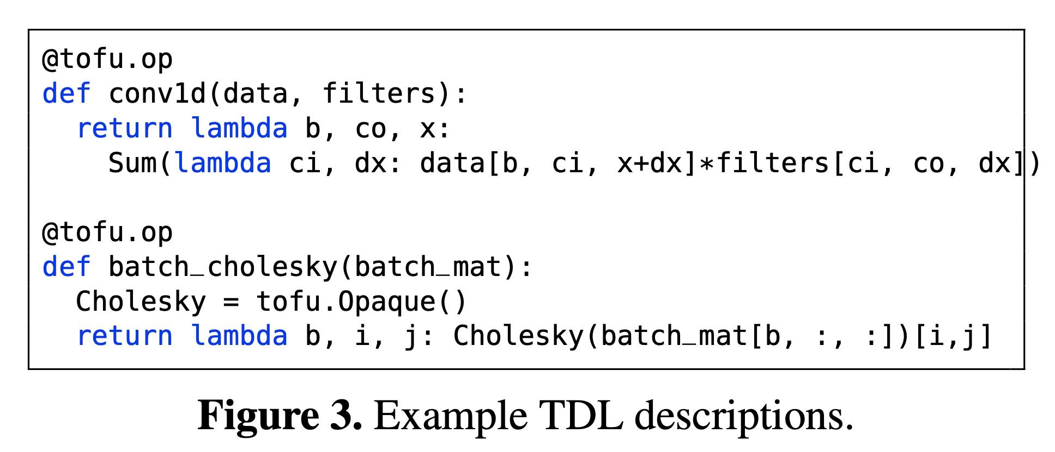
TDL
Tensor-as-a-lambda
Describe each operation in the model in TDL. This codifies how the data will flow through the model.
Allows for the construction of a dataflow graph and with symbolic interval analysis, the relationship between ranges of features in the input / output of an operator.

Slide 12
TDL Expressions
Index variables (i.e. arguments of the lambda function).
Tensor elements (e.g. filters[ci, co, dx]).
Arithmetic operations involving constants, index variables, tensor elements or TDL expressions.
Reduction over a tensor along one or more dimensions.

Slide 13
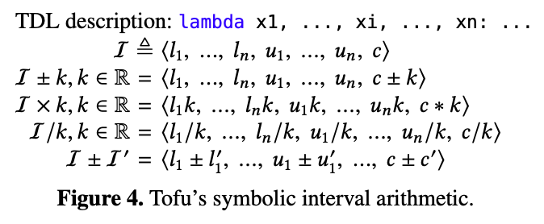
Symbolic Interval Analysis
Symbolic interval analysis allows Tofu to relate input and output tensor regions based on the operators between them.

Slide 14
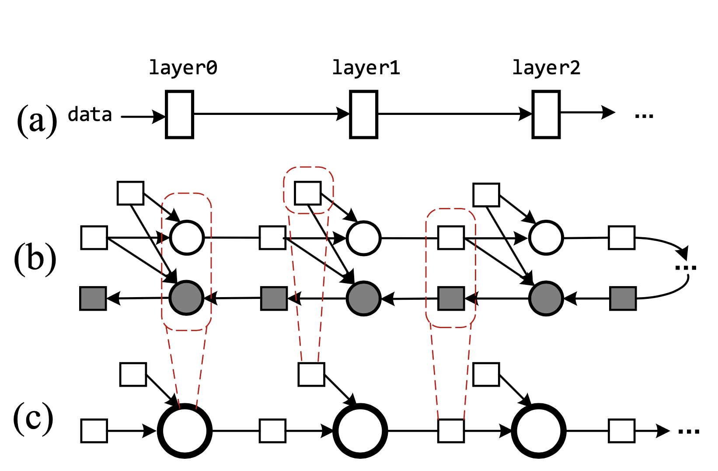
Graph Coarsening
Simplifies the dataflow graph.
Group forward and backward operations.
Coalesce element-wise operators.
Coalesce unrolled timesteps (RNN).
All of the tensors within an example of these groups have the same dataflow relationships.
Figure 5.

Slide 15
Generating Partition Strategies Using Recursive DP
At each step in a partitioning strategy a single dimension is chosen for splitting.
A key insight the authors had was that the search can be done recursively. Find the best single partition with DP and then repeat the search on either side until the there is a partition for every worker.
In some cases the number of workers is not a factor of 2. In these cases the number of workers is factored and partitions are made to fit the factors in descending order.

Slide 16
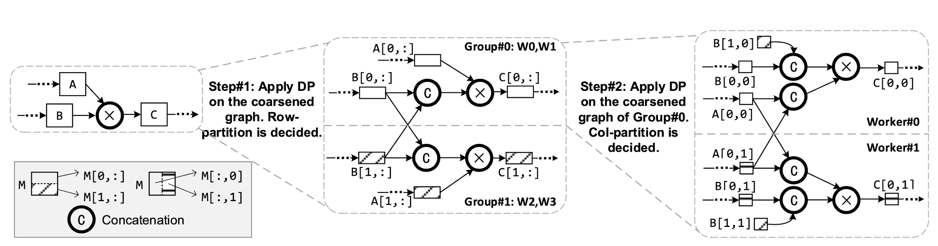
The resulting partitions:
Figure 6.

Slide 17
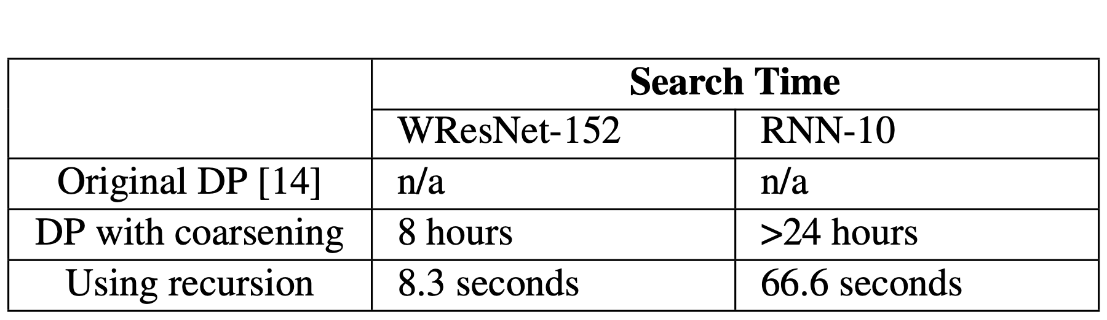
Partitioning Search Time
Coarsening the dataflow graph and performing a search for a single dimension to partition at a time instead of a combination of dimensions shrinks the search space dramatically. For a set of 6-4D tensors to be split among 8 workers, the full search all at once has 64,000,000 possibilities, but finding a single split recursively for 8 workers requires searching 3 recursive layers for a total of 12,288 options.
Table 1.

Slide 18
Optimizations
Necessary procedures for the system to be usable in existing frameworks.
Tofu adds dependencies between the model nodes executed on a worker so that the framework memory planner allows for memory reuse.
They also wrote a kernel they call MultiFetch in CUDA UVA. This was necessary because some workers need to fetch data from other workers and the MXNet processes for this require many intermediate representations. Their MultiFetch kernel avoids the intermediate representations and allows a process running on one GPU to directly access data on another.

Slide 19
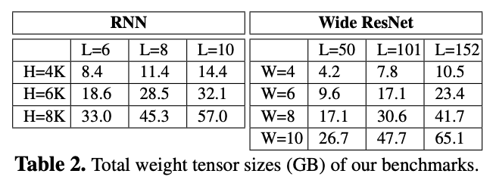
Evaluations - Throughput Benchmark Models
Two benchmark models are used. An LSTM RNN model and a Wide ResNet Model.
The RNN increases in size as the number of layers and the size of each layer’s hidden output increases.
The WResNet increases in size as the scaling factor (W) increases and the depth of the model increases.

Slide 20
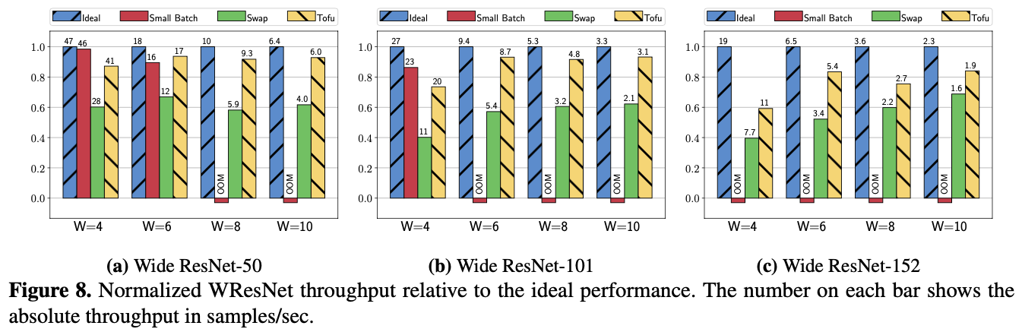
Evaluation - Throughput on Wide ResNet CNN
Notes:
Ideal: GPU has infinite memory - single GPU throughput * 8
SmallBatch: Tries to fit the model by reducing the batchsize - again single GPU * 8
Swap: Combination of many swapping methods

Slide 21
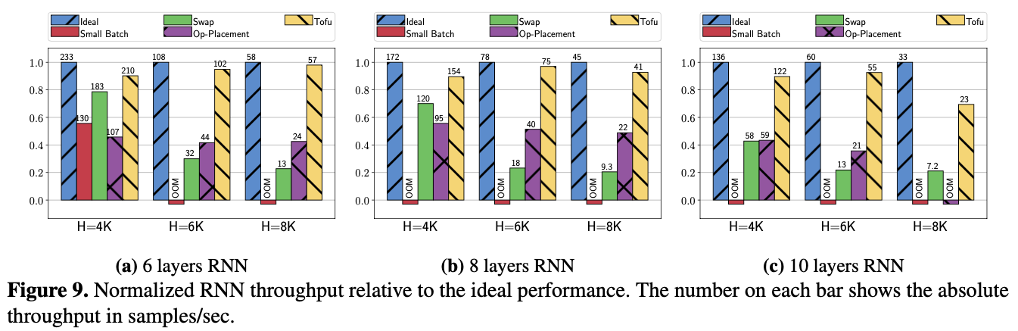
Evaluation - Throughput on LSTM cell RNN
Notes:
Op-Placement: Each Op on a separate worker

Slide 22
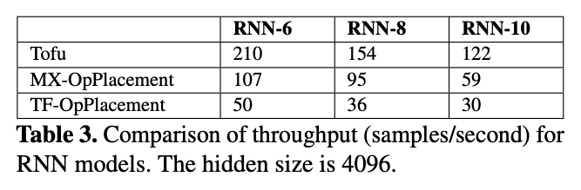
Evaluation - Throughput vs. Framework Op Placement
Notes:
TF doesn’t support in-place gradient aggregation

Slide 23
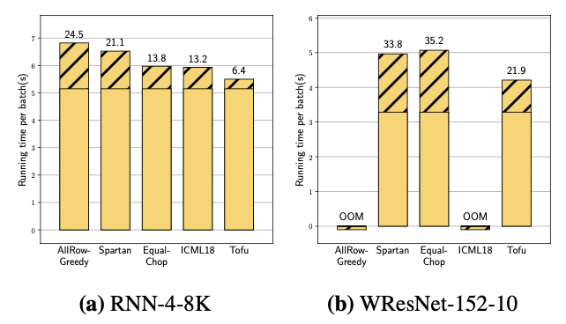
Evaluation - Running Time by Partition Strategy
Notes:
AllRowGreedy: partition all tensors on first dimension
Spartan: Partition largest tensor and its neighbors, then second largest, so on
EqualChop: use tofu, then partition each tensor along only one dimension
IMCL18: Basically tofu without considering output reduction and without recursion

Slide 24
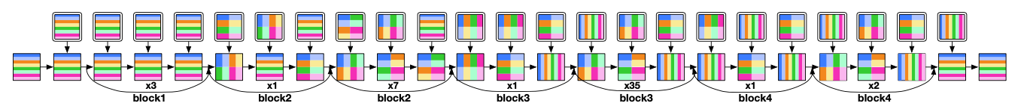
Tofu Partition on WResNet-152-10 on 8 GPUs
Notice the widely varied partitionings. They do not follow an easily predictable pattern outside of repeated groupings.

Slide 25
Conclusion
Tofu implements automatic graph partitioning at the tensor level
TDL and symbolic interval analysis allow Tofu to generate a dataflow graph
Coarsening the dataflow graph shrinks the search space for partitioning
Partitioning is done quickly and efficiently with recursive optimal DP
Partitioning optimizes for minimal communication across workers.
Implementations using Tofu outperform other current methods when the models are very large

